Slide 1
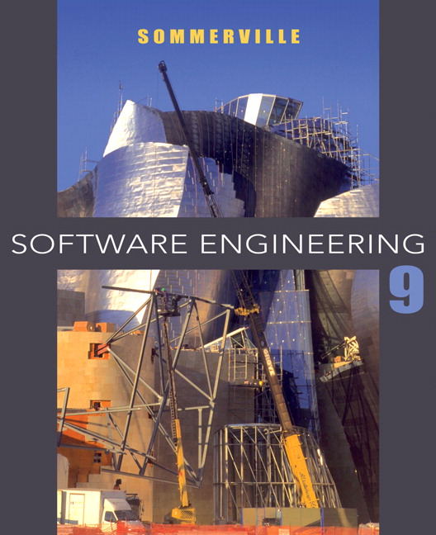
Chapter 1 – Introduction

Slide 2
Topics covered
Introduction to Software Engineering
Software process models
Iterative Process
Activity process
The Rational Unified Process
  An example of a modern software process.

Slide 3
INTRODUCTION TO SOFTWARE ENGINEERING
The economies of ALL developed nations are
dependent on software.
More and more systems are software controlled
Software engineering is concerned with theories, methods and tools for professional software development.

Slide 4
Software costs
Software costs often dominate computer system costs. The costs of software on a PC are often greater than the hardware cost.
Software costs more to maintain than it does to develop. For systems with a long life, maintenance costs may be several times development costs.
Software engineering is concerned with cost-effective software development.

Slide 5
Software products
Generic products
  Stand-alone systems that are marketed and sold to any customer who wishes to buy them.
  Examples – PC software such as graphics programs, project management tools; CAD software; software for specific markets such as appointments systems for dentists.
Customized products
  Software that is commissioned by a specific customer to meet their own needs.
  Examples – embedded control systems, air traffic control software, traffic monitoring systems.

Slide 6
Product specification
Generic products
  The specification of what the software should do is owned by the software developer and decisions on software change are made by the developer.
Customized products
  The specification of what the software should do is owned by the customer for the software and they make decisions on software changes that are required.

Slide 7
What is Software?
What is Software engineering?

Slide 8
Frequently asked questions about software engineering
Question | Answer
What is software? | Computer programs and associated documentation. Software products may be developed for a particular customer or may be developed for a general market.
What are the attributes of good software? | Good software should deliver the required functionality and performance to the user and should be maintainable, dependable and usable.
What is software engineering? | Software engineering is an engineering discipline that is concerned with all aspects of software production.
What are the fundamental software engineering activities? | Software specification, software development, software validation and software evolution.
What is the difference between software engineering and computer science? | Computer science focuses on theory and fundamentals; software engineering is concerned with the practicalities of developing and delivering useful software.
What is the difference between software engineering and system engineering? | System engineering is concerned with all aspects of computer-based systems development including hardware, software and process engineering. Software engineering is part of this more general process.

Slide 9
Frequently asked questions about software engineering
Question | Answer
What are the key challenges facing software engineering? | Coping with increasing diversity, demands for reduced delivery times and developing trustworthy software.
What are the costs of software engineering? | Roughly 60% of software costs are development costs, 40% are testing costs. For custom software, evolution costs often exceed development costs.
What are the best software engineering techniques and methods? | While all software projects have to be professionally managed and developed, different techniques are appropriate for different types of system. For example, games should always be developed using a series of prototypes whereas safety critical control systems require a complete and analyzable specification to be developed. You can’t, therefore, say that one method is better than another.
What differences has the web made to software engineering? | The web has led to the availability of software services and the possibility of developing highly distributed service-based systems. Web-based systems development has led to important advances in programming languages and software reuse.

Slide 10

What are the attributes of good software?
maintainability
Dependability and security
Efficiency
acceptability

Slide 11
Essential attributes of good software
Product characteristic | Description
Maintainability | Software should be written in such a way so that it can evolve to meet the changing needs of customers. This is a critical attribute because software change is an inevitable requirement of a changing business environment.
Dependability and security | Software dependability includes a range of characteristics including reliability, security and safety. Dependable software should not cause physical or economic damage in the event of system failure. Malicious users should not be able to access or damage the system.
Efficiency | Software should not make wasteful use of system resources such as memory and processor cycles. Efficiency therefore includes responsiveness, processing time, memory utilisation, etc.
Acceptability | Software must be acceptable to the type of users for which it is designed. This means that it must be understandable, usable and compatible with other systems that they use.

Slide 12
Software engineering
Software engineering is an engineering discipline that is concerned with all aspects of software production from the early stages of system specification through to maintaining the system after it has gone into use.
Engineering discipline
  Using appropriate theories and methods to solve problems bearing in mind organizational and financial constraints.
All aspects of software production
  Not just technical process of development. Also project management and the development of tools, methods etc. to support software production.

Slide 13
Why software engineering is important?

Slide 14
Importance of software engineering
More and more, individuals and society rely on advanced software systems. We need to be able to produce reliable and trustworthy systems economically and quickly.
It is usually cheaper, in the long run, to use software engineering methods and techniques for software systems rather than just write the programs as if it was a personal programming project. For most types of system, the majority of costs are the costs of changing the software after it has gone into use.

Slide 15
Application types
Stand-alone applications
  These are application systems that run on a local computer, such as a PC. They include all necessary functionality and do not need to be connected to a network.
Interactive transaction-based applications
  Applications that execute on a remote computer and are accessed by users from their own PCs or terminals. These include web applications such as e-commerce applications.
Embedded control systems
  These are software control systems that control and manage hardware devices. Numerically, there are probably more embedded systems than any other type of system.

Slide 16
Application types (cont.)
Batch processing systems
  These are business systems that are designed to process data in large batches. They process large numbers of individual inputs to create corresponding outputs.
Entertainment systems
  These are systems that are primarily for personal use and which are intended to entertain the user. (eg. Games app)
Systems for modelling and simulation
  These are systems that are developed by scientists and engineers to model physical processes or situations, which include many, separate, interacting objects.

Slide 17
Application types (cont.)
Data collection systems
  These are systems that collect data from their environment using a set of sensors and send that data to other systems for processing.
Systems of systems
  These are systems that are composed of a number of other software systems.

Slide 18
THE SOFTWARE PROCESS
A structured set of activities required to develop a
software system.
Many different software processes but all involve:
  Specification – defining what the system should do;
  Design and implementation – defining the organization of the system and implementing the system;
  Validation – checking that it does what the customer wants;
  Evolution – changing the system in response to changing customer needs.
A software process model is an abstract representation of a process. It presents a description of a process from some particular perspective.

Slide 19
Software process descriptions
When we describe and discuss processes, we usually talk about the activities in these processes such as specifying a data model, designing a user interface, etc. and the ordering of these activities.
Process descriptions may also include:
  Products, which are the outcomes of a process activity;
  Roles, which reflect the responsibilities of the people involved in the process;
  Pre- and post-conditions, which are statements that are true before and after a process activity has been enacted or a product produced.

Slide 20
Plan-driven and agile processes
Software processes can be categorized as:
  Plan-driven processes are processes where all of the process activities are planned in advance and progress is measured against this plan.
  In agile processes, planning is incremental and it is easier to change the process to reflect changing customer requirements.
In practice, most practical processes include elements of both plan-driven and agile approaches.
There are no right or wrong software processes.

Slide 21
SOFTWARE PROCESS MODELS
The waterfall model
  Plan-driven model. Separate and distinct phases of specification and development.
Incremental development
  Specification, development and validation are interleaved. May be plan-driven or agile.
Reuse-oriented software engineering
  The system is assembled from existing components. May be plan-driven or agile.
In practice, most large systems are developed using a process that incorporates elements from all of these models.

Slide 22
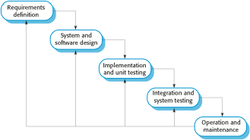
The waterfall model

Slide 23
Waterfall model phases
There are separate identified phases in the waterfall model:
  Requirements analysis and definition
  System and software design
  Implementation and unit testing
  Integration and system testing
  Operation and maintenance
The main drawback of the waterfall model is the difficulty of accommodating change after the process is underway. In principle, a phase has to be complete before moving onto the next phase.

Slide 24
Waterfall model problems
Inflexible partitioning of the project into distinct stages makes it difficult to respond to changing customer requirements.
  Therefore, this model is only appropriate when the requirements are well-understood and changes will be fairly limited during the design process.
  Few business systems have stable requirements.
The waterfall model is mostly used for large systems engineering projects where a system is developed at several sites.
  In those circumstances, the plan-driven nature of the waterfall model helps coordinate the work.

Slide 25
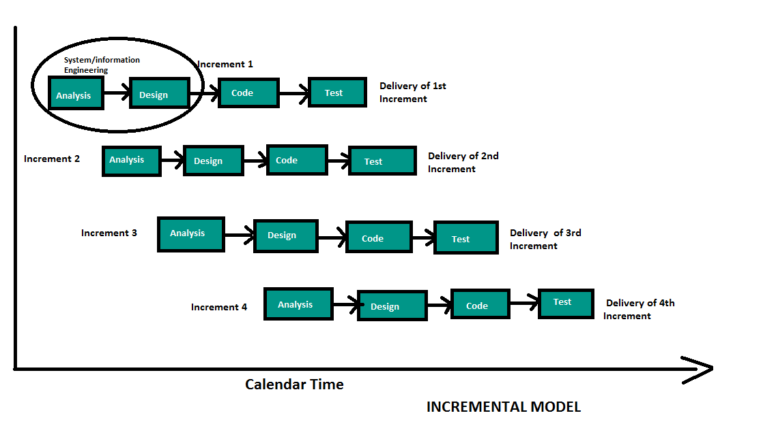
Incremental development

Slide 26

Incremental delivery
Rather than deliver the system as a single delivery, the development and delivery is broken down into increments with each increment delivering part of the required functionality.
User requirements are prioritised and the highest priority requirements are included in early increments.
Once the development of an increment is started, the requirements are frozen though requirements for later increments can continue to evolve.

Slide 27
Incremental development and delivery
Incremental development
  Develop the system in increments and evaluate each increment before proceeding to the development of the next increment;
  Normal approach used in agile methods;
  Evaluation done by user/customer proxy.
Incremental delivery
  Deploy an increment for use by end-users;
  More realistic evaluation about practical use of software;
  Difficult to implement for replacement systems as increments have less functionality than the system being replaced.

Slide 28
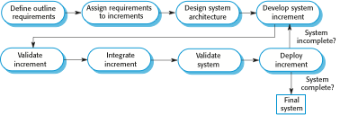
Incremental delivery

Slide 29
Incremental delivery advantages
Customer value can be delivered with each increment so system functionality is available earlier.
Early increments act as a prototype to help elicit requirements for later increments.
Lower risk of overall project failure.
The highest priority system services tend to receive the most testing.

Slide 30
Incremental delivery problems
Most systems require a set of basic facilities that are used by different parts of the system.
  As requirements are not defined in detail until an increment is to be implemented, it can be hard to identify common facilities that are needed by all increments.
The essence of iterative processes is that the specification is developed in conjunction with the software.
  However, this conflicts with the procurement model of many organizations, where the complete system specification is part of the system development contract.

Slide 31
Incremental development benefits
The cost of accommodating changing customer requirements is reduced.
  The amount of analysis and documentation that has to be redone is much less than is required with the waterfall model.
It is easier to get customer feedback on the development work that has been done.
  Customers can comment on demonstrations of the software and see how much has been implemented.
More rapid delivery and deployment of useful software to the customer is possible.
  Customers are able to use and gain value from the software earlier than is possible with a waterfall process.

Slide 32
Incremental development problems
The process is not visible.
  Managers need regular deliverables to measure progress. If systems are developed quickly, it is not cost-effective to produce documents that reflect every version of the system.
System structure tends to degrade as new increments are added.
  Unless time and money is spent on refactoring to improve the software, regular change tends to corrupt its structure. Incorporating further software changes becomes increasingly difficult and costly.

Slide 33
Reuse-oriented software engineering
Based on systematic reuse where systems are integrated from existing components or COTS (Commercial-off-the-shelf) systems.
Process stages
  Component analysis;
  Requirements modification;
  System design with reuse;
  Development and integration.
Reuse is now the standard approach for building many types of business system
  Reuse covered in more depth in Chapter 16.

Slide 34

Reuse-oriented software engineering

Slide 35
Types of software component
Web services that are developed according to service standards and which are available for remote invocation.
Collections of objects that are developed as a package to be integrated with a component framework such as .NET or J2EE.
Stand-alone software systems (COTS) that are configured for use in a particular environment.

Slide 36
Reuse-oriented software engineering
Advantage
Reduce amount of application to be developed
Reduce cost and risks
Faster delivery of software
Drawbacks
Requirements compromise leads to system that does not meet real user’s requirements

Slide 37
ITERATIVE PROCESS
Change is inevitable in all large software projects.
  Business changes lead to new and changed system requirements
  New technologies open up new possibilities for improving implementations
  Changing platforms require application changes
Iterative process model:
  Software prototyping

Slide 38
Software prototyping
A prototype is an initial version of a system used to demonstrate concepts and try out design options.
A prototype can be used in:
  The requirements engineering process to help with requirements elicitation and validation;
  In design processes to explore options and develop a UI design;
  In the testing process to run back-to-back tests.

Slide 39
Benefits of prototyping
Improved system usability.
A closer match to users’ real needs.
Improved design quality.
Improved maintainability.
Reduced development effort.

Slide 40

The process of prototype development

Slide 41
Prototype development
May be based on rapid prototyping languages or tools
May involve leaving out functionality
  Prototype should focus on areas of the product that are not well-understood;
  Error checking and recovery may not be included in the prototype;
  Focus on functional rather than non-functional requirements such as reliability and security

Slide 42
Throw-away prototypes
Prototypes should be discarded after development as they are not a good basis for a production system:
  It may be impossible to tune the system to meet non-functional requirements;
  Prototypes are normally undocumented;
  The prototype structure is usually degraded through rapid change;
  The prototype probably will not meet normal organisational quality standards.

Slide 43
THE RATIONAL UNIFIED PROCESS (RUP)
A modern generic process derived from the work on the UML and associated process.
Brings together aspects of the 3 generic process models discussed previously.
Normally described from 3 perspectives
  A dynamic perspective that shows phases over time;
  A static perspective that shows process activities;
  A practice perspective that suggests good practice.

Slide 44

Phases in the Rational Unified Process

Slide 45
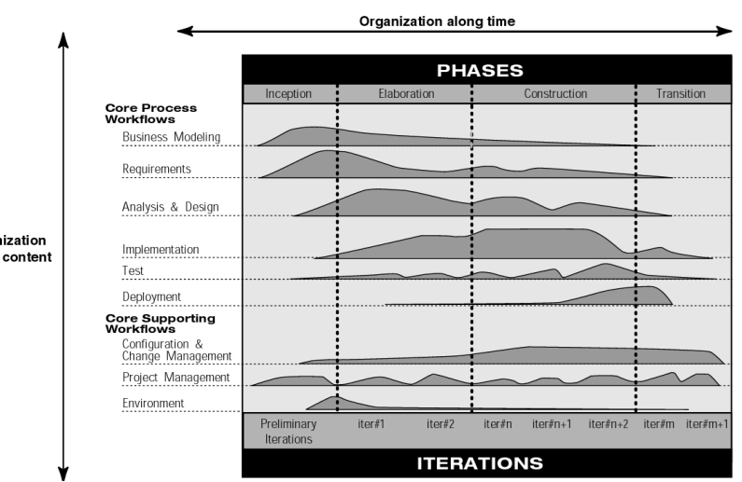
Phases in the Rational Unified Process

Slide 46

RUP phases
Phases are goal directed and yield deliverables:
Inception – Establish the business case. Identify external entities (actors, systems). Estimate ROI.
Elaboration – Understand problem domain.
Establish architecture, and consider design trade-offs. Identify project risks. Estimate and schedule project. Decide on build vs. buy.
Construction – Design, program and test. Components are bought and integrated.
Transition – release a mature version and deploy in real world.

Slide 47
RUP good practice
Develop software iteratively
  Plan increments based on customer priorities and deliver highest priority increments first.
Manage requirements
  Explicitly document customer requirements and keep track of changes to these requirements.
Use component-based architectures
  Organize the system architecture as a set of reusable components.

Slide 48
RUP good practice (cont.)
Visually model software
  Use graphical UML models to present static and dynamic views of the software.
Verify software quality
  Ensure that the software meet’s organizational quality standards.
Control changes to software
  Manage software changes using a change management system and configuration management tools.

Slide 49
Key points
Software engineering is an engineering discipline that is concerned with all aspects of software production.
Essential software product attributes are maintainability, dependability and security, efficiency and acceptability.
The high-level activities of specification, development, validation and evolution are part of all software processes.
The fundamental notions of software engineering are universally applicable to all types of system development.

Slide 50
Key points
There are many different types of system and each requires appropriate software engineering tools and techniques for their development.
The fundamental ideas of software engineering are applicable to all types of software system.

Slide 51
Key points
Software processes are the activities involved in producing a software system. Software process models are abstract representations of these processes.
General process models describe the organization of software processes. Examples of these general models include the ‘waterfall’ model, incremental development and reuse-oriented development.
Iterative process model includes software prototyping.

Slide 52
Key points
The Rational Unified Process is a modern generic process model that is organized into phases (inception, elaboration, construction and transition) but separates activities (requirements, analysis and design, etc.) from these phases.

